Slide 1
RStudio Features and Sparklyr
Sai Chimata

Slide 2
Agenda
Integrated Development Environment (IDE) for R
Connections
Version Control
RStudio - Terminal
Multiple Sessions
Multiple R versions
RMarkdown
Package Management & RStudio Package Manager
Package Management with Packrat
Packages & Installation
Package Collaboration
Packrat Commands
Debugging
Sharing Projects
Opening Sharing Projects
Q&A

Slide 3
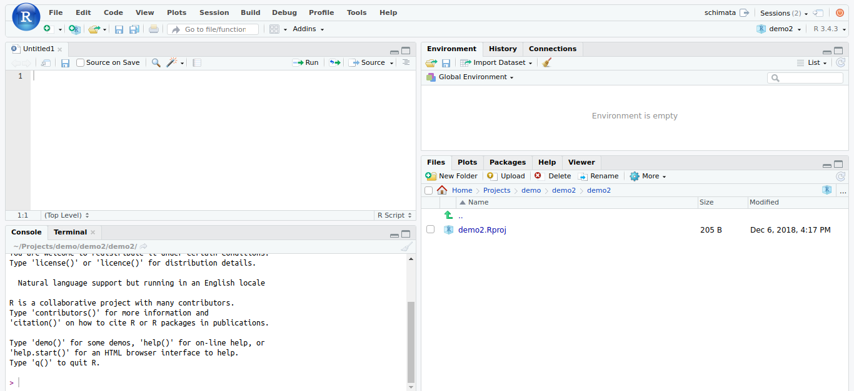
RStudio: An Integrated Development Environment (IDE) for R
Source / Code
Environment / Connections
Console / Terminal
Files / Plots / Packages / Help / Viewer

Slide 4

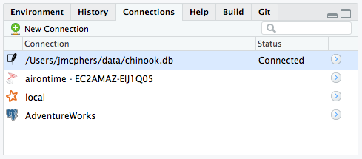
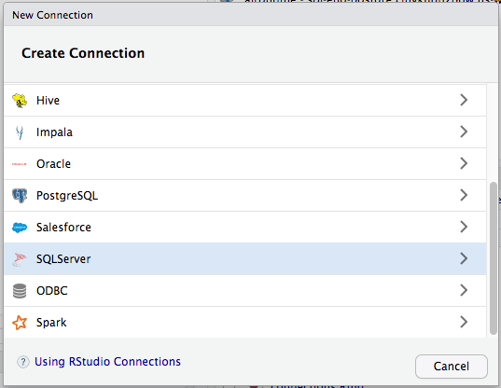
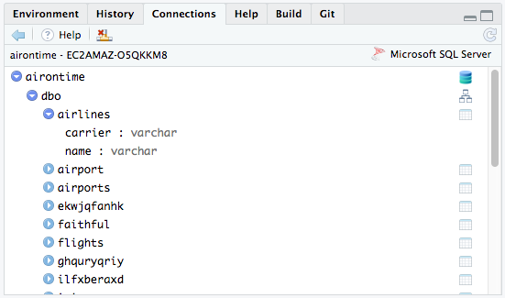
Connections
New connection to existing DB
Opening an Existing connection
Exploring an Existing connection

Slide 5
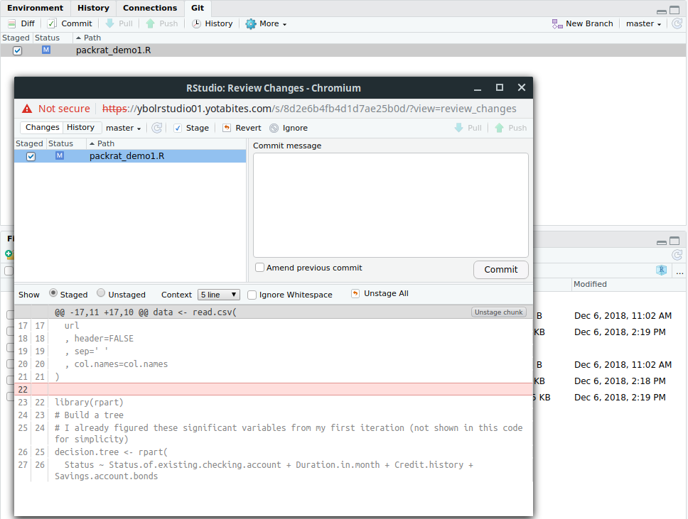
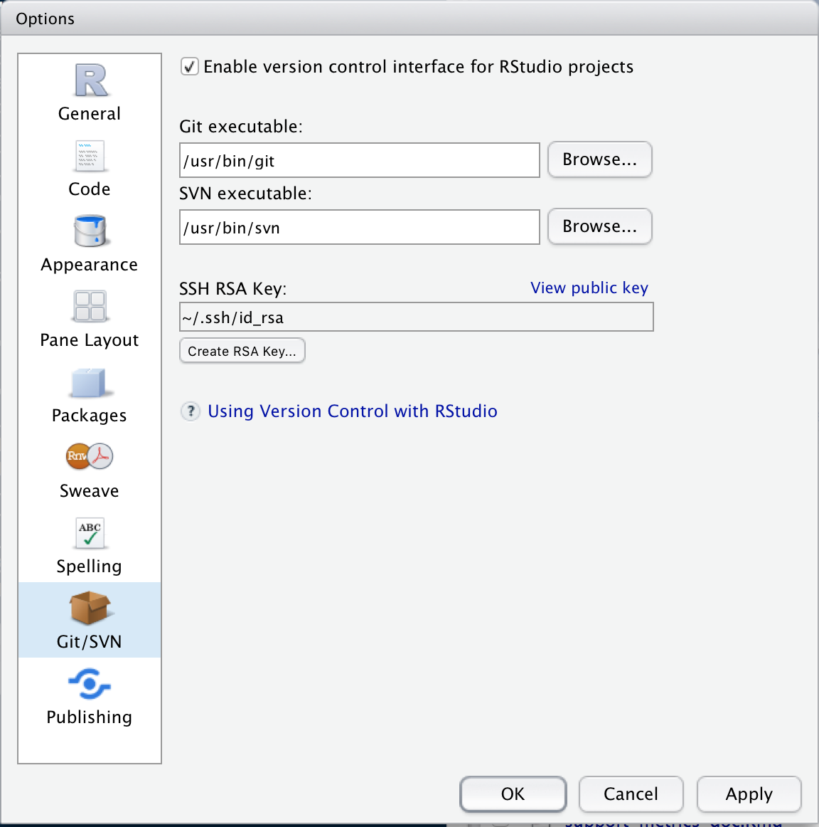
Version Control
Version control helps software teams manage changes to source code over time.
Go to Global Options (from the Tools menu)
Click Git/SVN, Enable version control interface for RStudio projects
If necessary, enter the path for your Git or SVN executable where provided.
You can also create or add your RSA key for SSH if necessary.
Git GUI can be used to perform local actions
Terminal can be used to push/pull from github/Bitbucket repositories

Slide 6
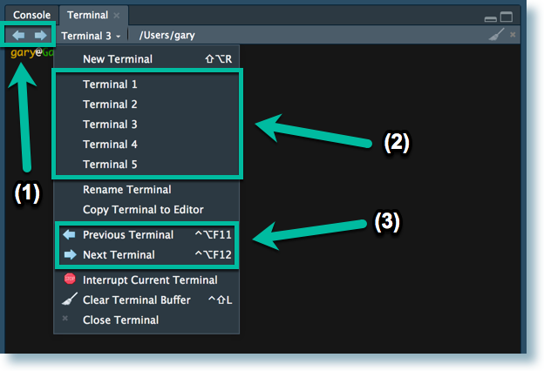
Terminal
The RStudio terminal provides access to the system shell from within the RStudio IDE.
To move focus to the terminal Shift+Alt+T (Tools->Terminal->Move Focus to Terminal)
RStudio supports multiple terminal sessions. To start another terminal session, use the New Terminal command on the Terminal drop down menu, or Shift+Alt+R.
When editing files in the RStudio editor, any selection (or the current line if nothing is selected) can be sent to the active terminal via Ctrl+Alt+Enter (also Cmd+Alt+Enter on the Mac). If a single-line was sent to the terminal the cursor will advance automatically to the next line, allowing single-stepping.
To close a terminal session, use the Close Terminal command on the Terminal drop down menu, click the [x] on the far-right of the Terminal pane toolbar, or type exit from within the shell itself.
Git commands can be executed through terminal and also Rscripts can be executed through terminal
Ex: In terminal - Rscript example.R

Slide 7
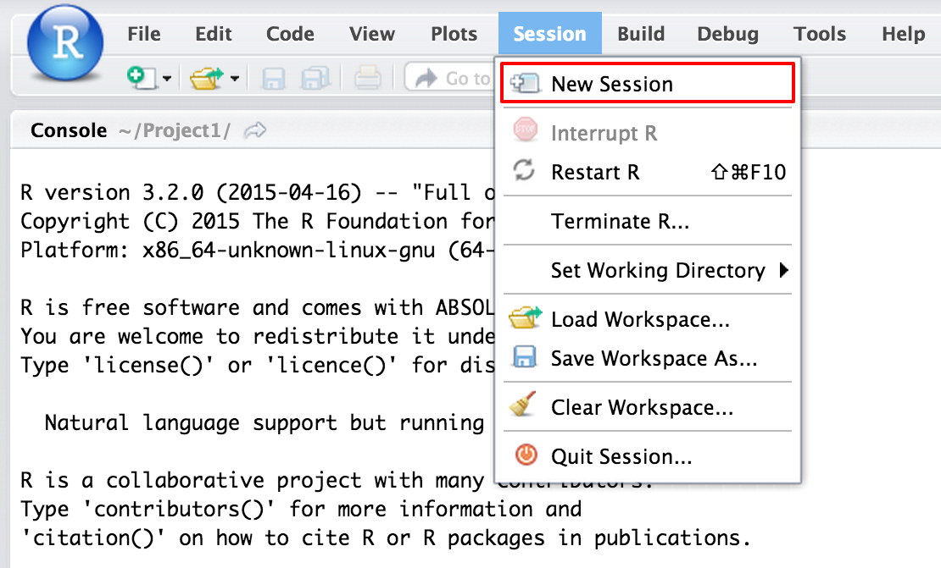
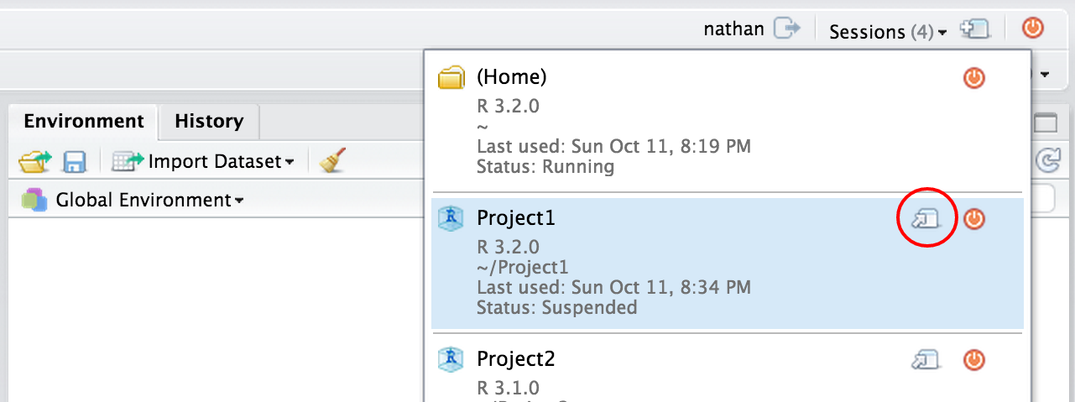
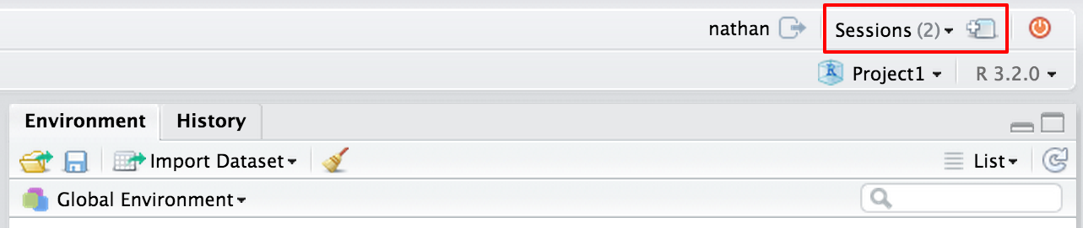
Multiple Sessions
RStudio Server Pro gives you the ability to open multiple concurrent sessions. Multiple concurrent sessions can can be useful when you want to:
Run multiple analyses in parallel
Keep multiple sessions open indefinitely
Participate in one or more shared projects
New session will create a session under your current project. You can see all active sessions by clicking the “Sessions” button on the top toolbar
The drop down menu will list all active sessions and let you open individual sessions or all sessions simultaneously by clicking on the icon to open it up in a separate tab.

Slide 8
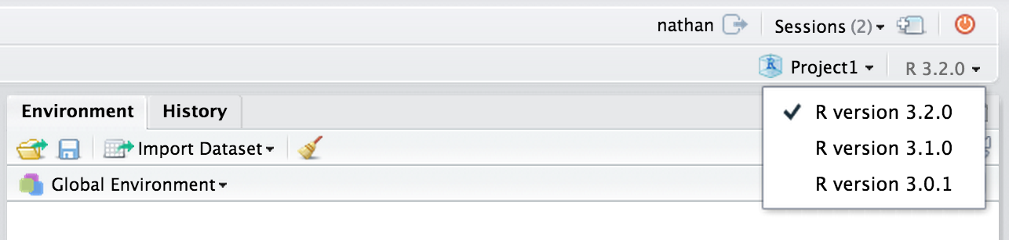
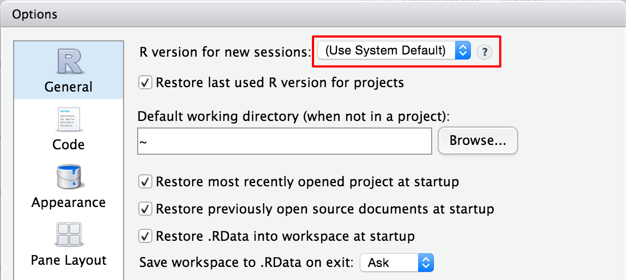
Multiple R versions
RStudio Server Pro gives you the ability to select multiple versions of R from within the IDE. Access to multiple versions of R can be useful for the following tasks:
Manage upgrades of R
Test code on a variety of R versions and distributions
Support projects that depend on various versions of R
You can also control the default version of R for new sessions by changing the global options (under Tools -> Global Options). New sessions will automatically be set to the selected version of R.
You can select different versions of R by selecting it from the drop down list at the top of the browser window.

Slide 9
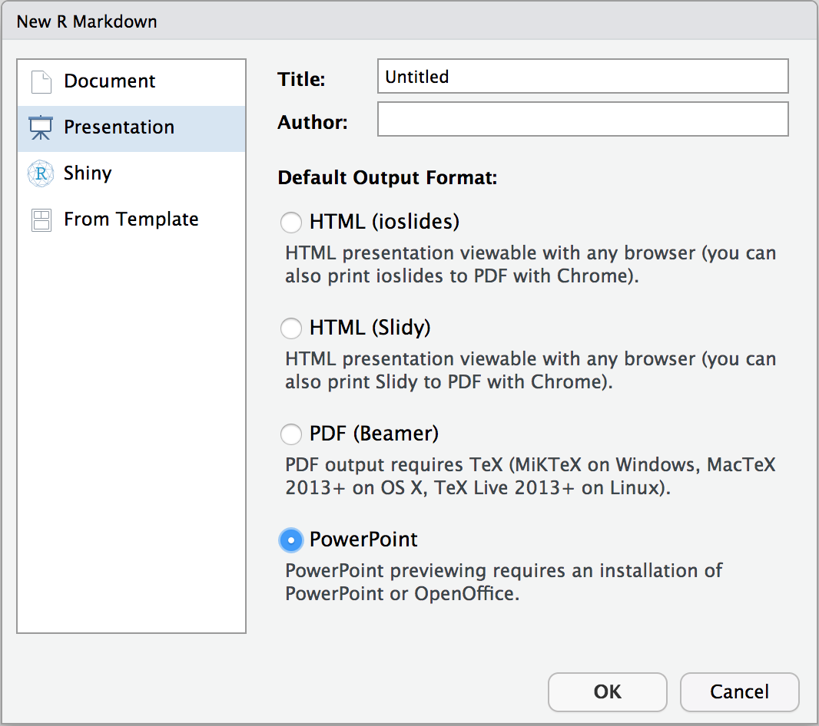
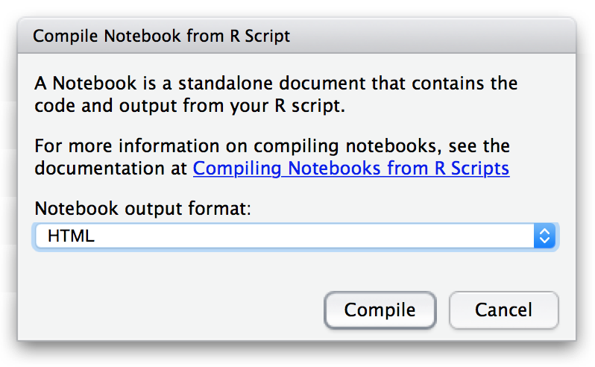
RMarkdown
R Markdown provides an authoring framework for data science. You can use a single R Markdown file to both
save and execute code
generate high quality reports that can be shared with an audience
R Markdown documents are fully reproducible. Use multiple languages including R, Python, and SQL etc.
R Markdown supports dozens of static and dynamic formats including HTML, PDF, MS Word, Beamer, HTML5 slides, books, dashboards, shiny applications, websites , and more.
R includes a powerful and flexible system Sweave for creating dynamic reports and reproducible research using LaTeX.
knitr is an R package that adds many new capabilities to Sweave and is also fully supported by RStudio.
Knitr can be used to compile Notebook from R script
Additional Reading: RMarkdown

Slide 10
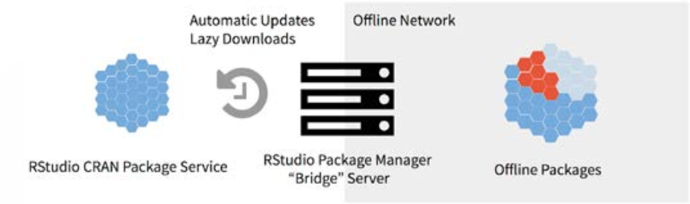
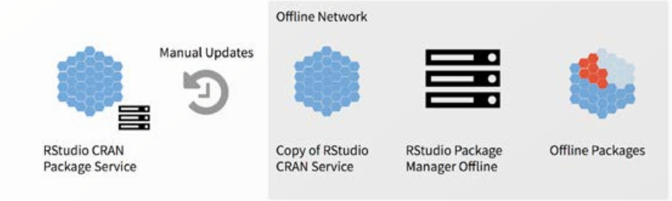
Package Management & RStudio Package Manager
There are three general strategies for managing R libraries at Organization level:
Install all packages in user libraries. This strategy also duplicates commonly used packages.
Install all packages in common libraries. This strategy forces the administrator to manage all packages.
Install some packages in common libraries and some in user libraries. This strategy allows frequently used packages to be installed in common libraries while still giving users the ability to install user specific packages.
RStudio Package Manager solves package management problems by creating a central location for R packages.
RStudio Package Manager is a repository management server to organize and centralize R packages.
Get offline access to CRAN, automate CRAN syncs, share local packages, restrict package access, find packages across repositories, and more.
Ensures standardization and consistency across organization.

Slide 11
RStudio Package Manager - Architecture
Organization
CRAN
RStudio
Port:4242
RSPM
Architecture of Rstudio Package Manager
RS Connect

Slide 12
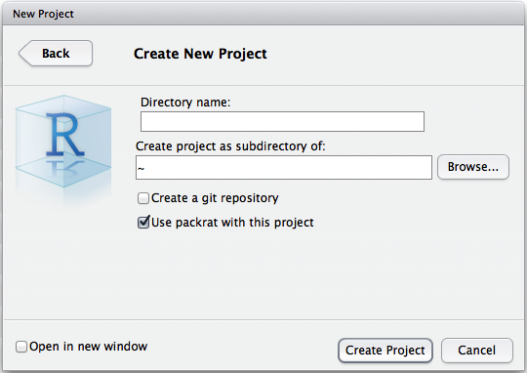
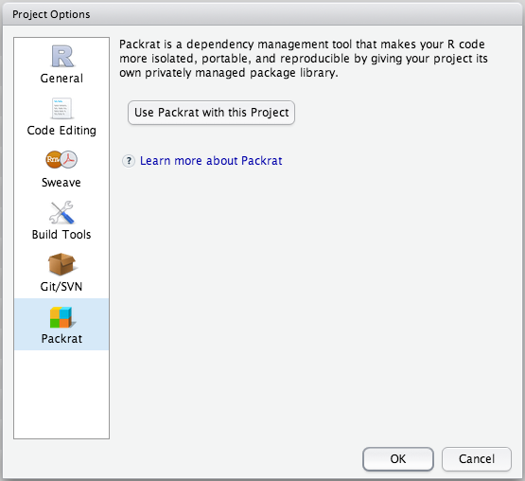
Package Management with Packrat
Packrat is a dependency management system for R at Project level.
Use packrat to make your R projects more:
Isolated: Installing a new or updated package for one project won't break your other projects, and vice versa. That's because packrat gives each project its own private package library.
Portable: Easily transport your projects from one computer to another, even across different platforms. Packrat makes it easy to install the packages your project depends on.
Reproducible: Packrat records the exact package versions you depend on, and ensures those exact versions are the ones that get installed wherever you go
Project Initialization
starting a new project, you can start with Packrat right away
If you have an existing RStudio project you’d like to bring under Packrat control, you can add it using the new Packrat section under Tools | Project Options.
Command - packrat::init()

Slide 13
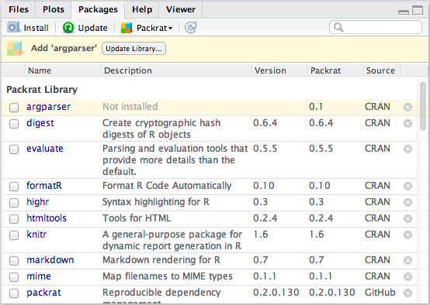
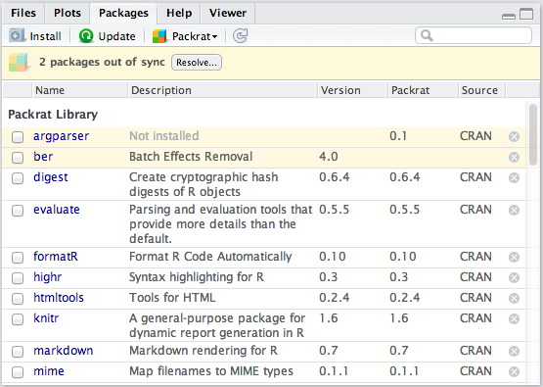
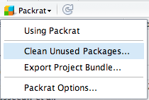
Package Collaboration
For instance, let’s say your collaborator adds a package called ‘argparser’ as part of a commit. When the packrat.lock file is updated by the version control system, RStudio will prompt you to bring your library in sync.
In some cases, however, it won’t be possible for RStudio to guess. Let’s imagine that you ignored your colleague’s changes and added a package of your own, ‘ber’. This will generate a conflict.
Package libraries can grow over time to include many packages that were needed at one time but are no longer used. You can clean these up with the Clean Unused Packages command.

Slide 14
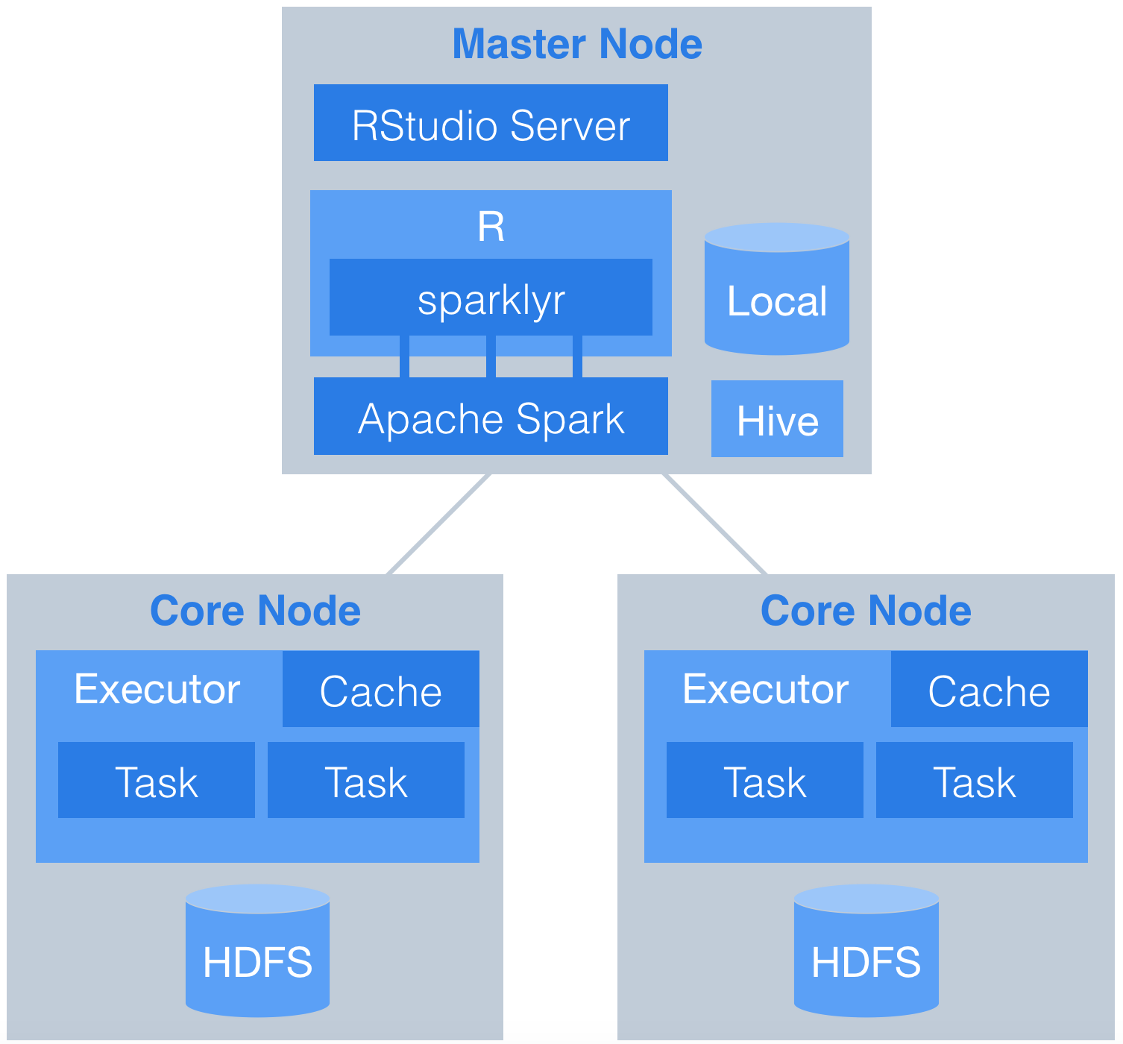
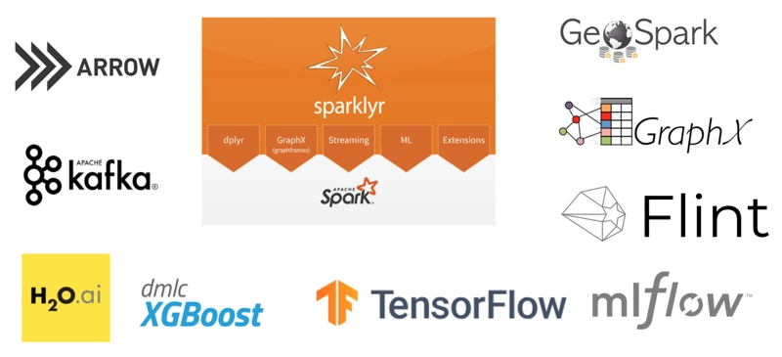
Package - Sparklyr
R interface to Apache Spark, a fast and general engine for big data processing. This package supports connecting to local and remote Apache Spark clusters, provides a 'dplyr' compatible back-end, and provides an interface to Spark's built-in machine learning algorithms.
Sparklyr Architecture
Sparklyr functionality and Integration capabilities

Slide 15
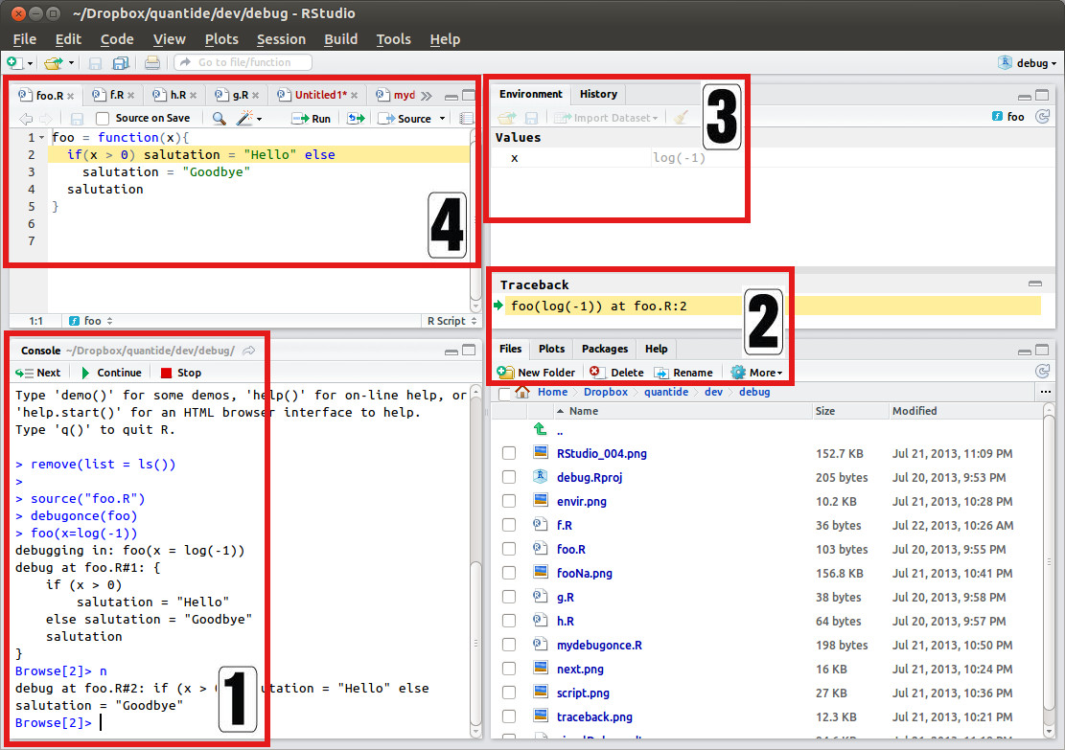
Debugging
Console Just below the console bar a new bar appears showing three buttons: Next, Continue, Stop
Traceback On the right hand side of RStudio, in between the lower and the upper panel a new panel named Traceback appears
Environment The upper panel on the right hand side shows, as usual, a tab named Environment. When debug mode is not activated, this tab lists the objects existing in the .GlobalEnv.
Highlighting Represented by the highlighting of line being debugged at any step. RStudio opens the file corresponding to the function being debugged and, each time the next button is pressed, the evaluator moves to the next line.

Slide 16
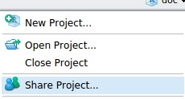
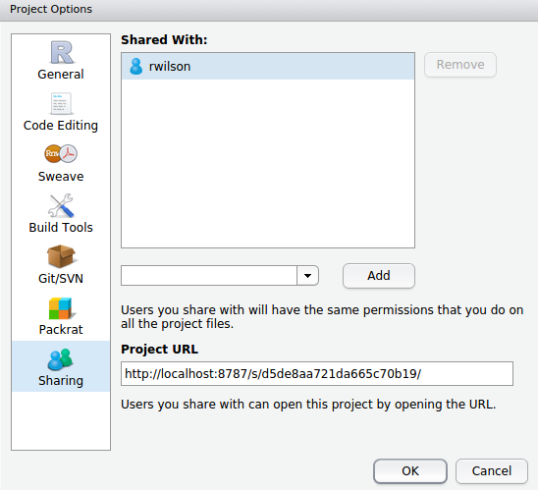
Sharing Projects
Project Sharing is a feature of RStudio Server Pro that allows you to share your projects with other users on the server.
Create a project to host the content you wish to share if you haven't already.
Once you've got a project, drop the the Project menu in the upper right and click Share Project.
Individual files cannot be shared
Sharing project will open the Sharing section in Project Options
Add users by typing system usernames next to Add
E-mail address can also be used if your server uses Google authentication.
Individuals username is located in the upper right corner of the screen

Slide 17
Q&A

Slide 18
References
https://support.rstudio.com/hc/en-us/sections/200150693-RStudio-Server
https://www.rstudio.com/products/rstudio/features/
https://rstudio.github.io/packrat/
https://www.r-project.org/nosvn/pandoc/packrat.html
https://support.rstudio.com/hc/en-us/sections/200149716-R-Markdown
https://www.r-bloggers.com/version-control-with-git/
https://support.rstudio.com/hc/en-us/articles/215733837-Managing-libraries-for-RStudio-Server
https://www.rstudio.com/products/package-manager/

